Slide 1
Theme 7. Conventional methods of speech processing: compressors and AGC

Slide 2
What is compression?
Dynamic range compression is a process in audio processing used to help even out the loud and quiet parts of a sound in a recorded track.
It’s considered an essential task in mixing music alongside equalization and applying audio effects like reverb and delay.
In fact, compression is an essential skill for all music producers that has a huge impact on everything from drums to modern studio vocals.
Dynamic range compression is completely different from the data compression methods used to make digital files smaller for storage or transmission.

Slide 3
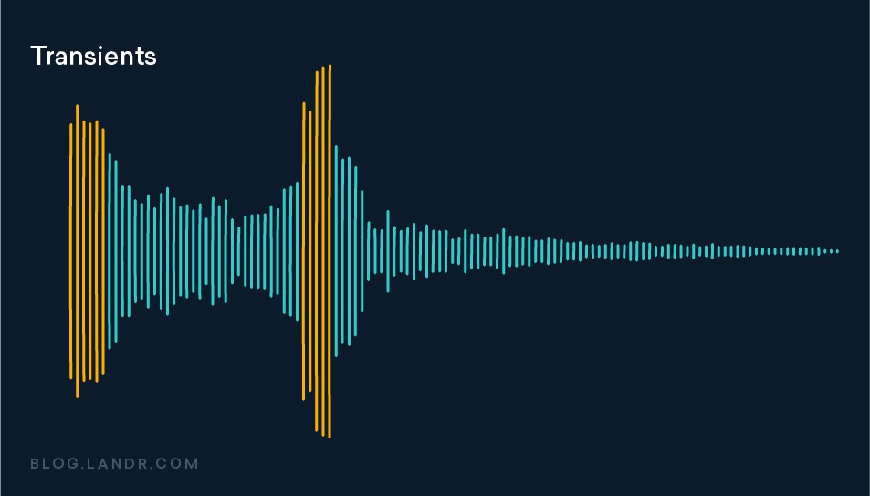
Why is audio compression used in processing?
Compression is used in music to reduce the dynamic range of signals with loud and quiet elements so that both can be heard clearly.
Think of the difference between a soft sound like a whispered vocal and the aggressive crack of a snare drum. To make them both heard on a recording, the mix engineer has to manage the dynamics.
But even within the same sound, quiet details can be easily overshadowed by the loudest moments.
A good way to understand it is to think of the sound of a recorded drum set. The fast onset of sound when the stick hits the drum skin is a clear example of a transient.
It’s the term for the initial burst of energy when a sound starts.
In most sounds, the transient is the loudest moment in the signal. To hear the transients equally with the body of the sound, compression is often necessary.
To go back to the drum example, compression lowers the level of the loud stick hits, and raises the level of each drum’s sustaining tone along with the decay of the sound in the room.

Slide 4
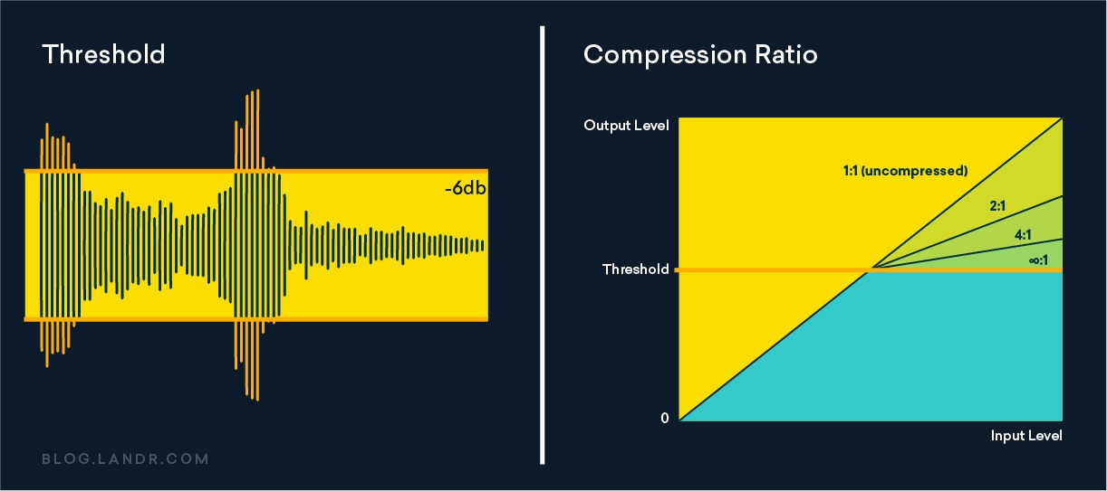
How does compression work?
The basic effect of a compressor is to reduce the volume of a signal once it passes a certain level.
A compressor includes several controls to help you control exactly how it behaves:
Threshold
The level where the compressor begins working is called the threshold—you set it with a dB control to determine the parts of the signal the compressor acts on.
Set the threshold high and the compressor will only reduce the gain of the most aggressive transients
Set the threshold lower and it compresses more of the signal.
Ratio
The ratio control determines how much the compressor reduces the gain once the signal passes the threshold.
Ratio is written as a comparison with the unaffected signal. The higher the first number in the ratio, the more intense the compression.
A compressor with an extremely aggressive ratio is called a limiter, since it doesn’t let any signal pass the threshold. If you can’t compare the compressed signal to the uncompressed signal, the ratio is actually ∞:1!

Slide 5
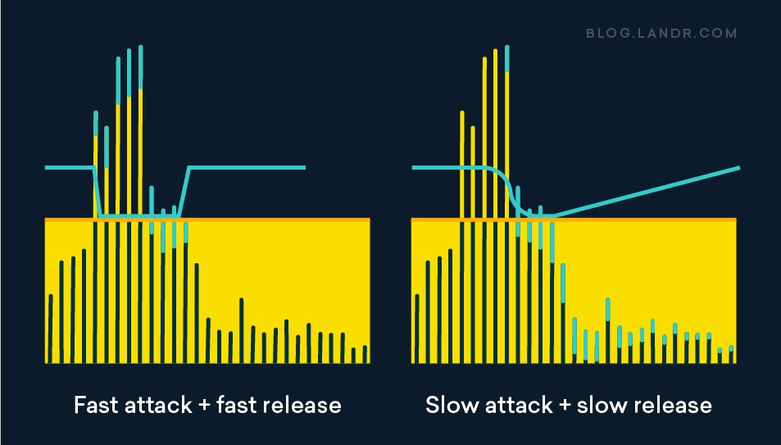
How does compression work?
Attack and release
Attack and release determine the timing of the compressor’s action. These are the key controls for making your compression sound musical and pleasing.
A fast attack setting is good for controlling aggressive transients like those of a picked bass guitar
A slow attack time will let some of the sound’s transient through to keep some punch and dynamics—this is often helpful for drums and samples
A fast release can help create a sense of pressure and rhythmic action to the sound
A slow release can make the compressor’s action seem less pronounced and more subtle
Compressor with zero attack becomes automatic gain control - instantly brings the signal to a certain level

Slide 6
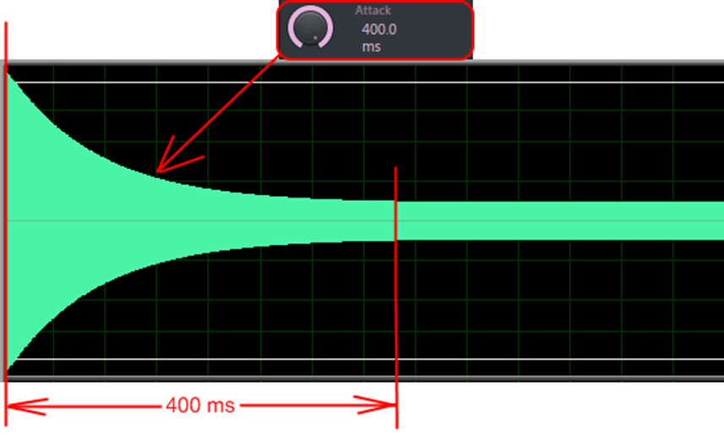
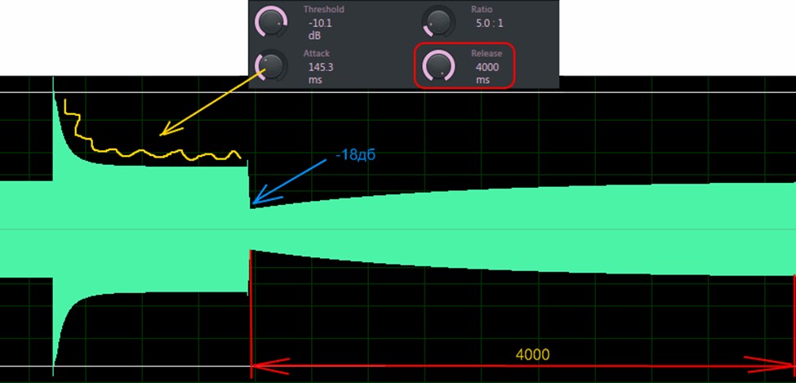
Basic example
Let the input signal is 0 dB. Compressor threshold -10 dB. The compression ratio is 5:1.
Then the resulting signal will be loudness threshold+ +(threshold/compression) = -10 + (-10.5) = -8 dB.
Attack shows how long the compressor will change the signal from the current to the set one, release - how long the signal will release when the input volume changes

Slide 7
How to use a compressor properly
1. Do I need it?
Many sounds you work with won’t have much dynamic range to start with.
In these cases, audio compression isn’t necessary and can even have a negative effect.
2. What parts of the sound get louder or quieter?
As you increase the intensity of the compression, listen for which aspects of the signal come out.
Does it revealing more of the details or burying the important parts?
Focus on the parts of the sound you want to ‘fix’ as you apply compression.
3. Does it help the sound?
Good compression should enhance the basic musical qualities of the song.
If you’re using it on drums, it should make the groove heavier. If you’re using it on speech it should hide the mistakes and reveal hidden parts.

Slide 8
Common mistakes and misuses
Attack too fast
When the attack is too fast, the transients will be pushed down too far into the body of the sound to pierce through a dense audioflow.
Threshold too low
You might think that cranking the threshold down will increase the intensity of the compression effect.
If the threshold is set so low that the compressor never releases, you’re not really hearing what it can do!
In many cases, musical compression means you’ll see the gain reduction needle jumping and bouncing along in time with the beat.
A faster release setting can intensify the ‘pumping’ sound that’s sometimes associated with heavy compression—especially on drums
Audio compression instead of levelling
This also might sound counterintuitive, but sometimes a compressor can’t control very large swings of dynamic range in an uneven performance.
This can be particularly clear when compressing speech, especially if there are quieter phrases alongside yelled or belted parts.
In these situations you shouldn’t expect a single compressor to provide enough transparent gain reduction to even out the entire flow.
In fact, if one segment causes your compressor to work dramatically harder, you should consider clipping gain to control the level that feeds into it

Slide 9
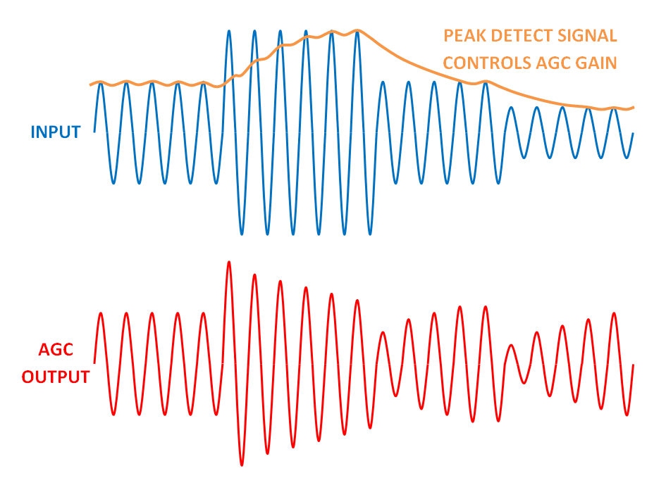
Automatic gain and loudness control (AGC and ALC)
An AGC amplifier maintains a constant output level while the input receiving signal varies across a very wide dynamic range.
An ALC normally has a known input signal level and it is used to adjust the output level (such as audio volume, RF power, etc.).
AGC typically applies to receivers. In any band of frequencies, there exists the channel you want to receive plus interferers. To guarantee certain SNDR at the ADC output, you need to have a particular input signal amplitude to the ADC. If your channel is weaker than that level, you need to re-adject the gains in the receiver chain to get your channel level right and vice versa.
ALC refers to level adjustment loops. This can be applied to any circuit not an entire system or sub-system. A prime example is ALC loops used to regulate oscillator's amplitude to suppress amplitude noise.

